Slide 1







Forecast subway demand at new stations
Data Mining
Team Project
17102051 YoungChul Shin 19102092 HyeonYeong Seo

Slide 2



Table of contents
Purpose of analysis
Data Set
Methods
Result
Case in Korea
Purpose of analysis
Data Set
Methods
Result
Case in China

Slide 3

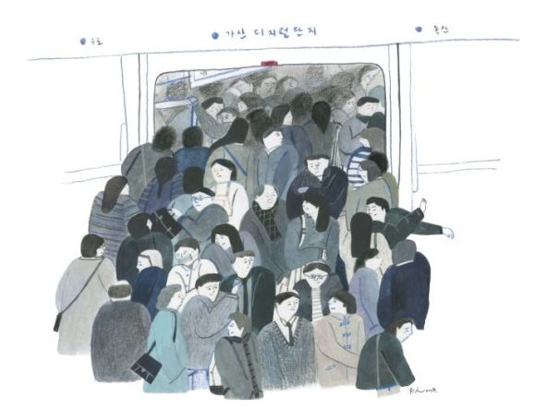
<Purpose of data analysis>
Citizens
Government
- Jam-packed subway
- Degree of congestion
- Inconvenience
Need to Forecast subway
demand at new stations
Need to save the social cost
Need to establish efficient
subway operation plans
Actual number of subway passengers
Initial estimated demands

Slide 4

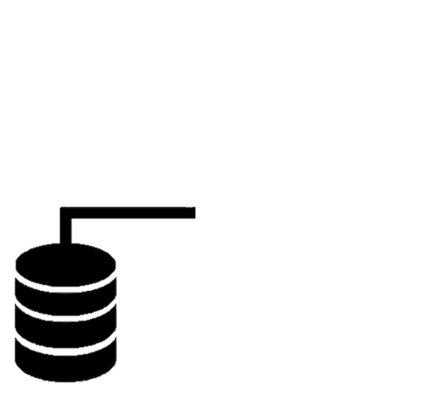
<Data Set>
2013.01 ~ 2018.03
The number of passengers in 246 of Seoul subway stations
information of station
and nearby facilities
weather
information
local
information
External factors affecting subway demand

Slide 5



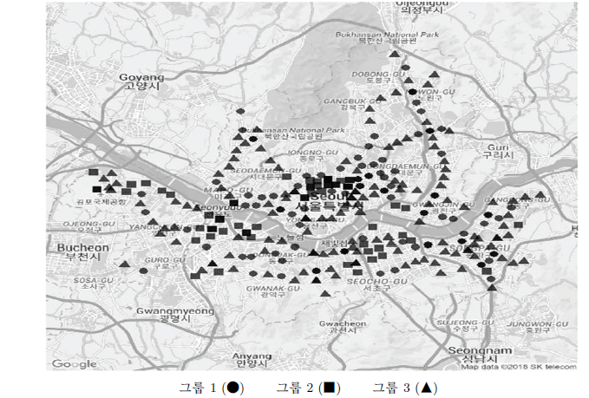
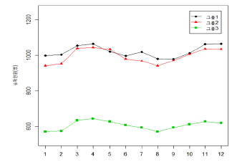
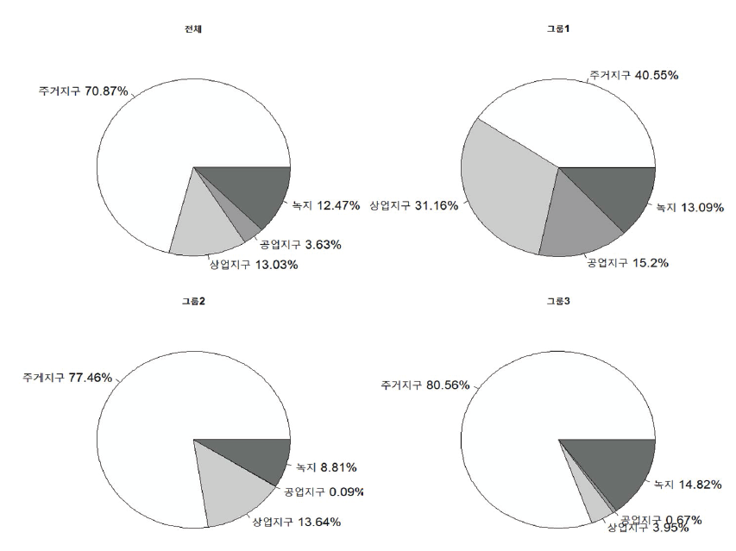
<Cluster analysis>
Location of subway stations by group
GMM clustering -> 3types of 249 stations
Monthly average of each response by group

Slide 6


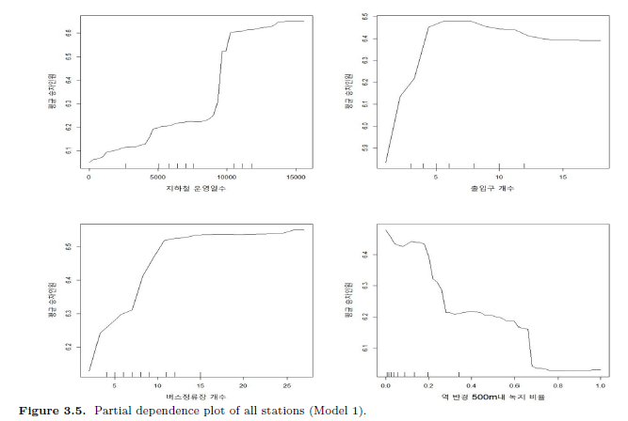
<Cross test of linear and nonlinear models>

Slide 7

<Result of Data Analysis>
The largest error in the case of the avg # of passengers per month
= 66 in group 1
Error improved~!
Predicted # of passengers in Subway stations newly established for 3 months
-avg demand per month: 241~452
-max demand per hour per month: 969~1515

Slide 8




<Effect of Analysis>
Efficiently control the interval between subway
to meet the demand of rides
Maximize customer satisfaction
Maximum efficiency with minimal cost

Slide 9
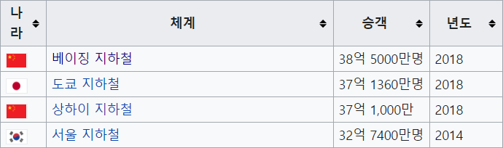
Ranking of the number of subway passengers worldwide

Slide 10
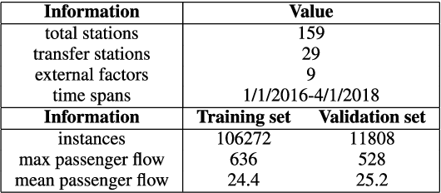
<Data Set>

Slide 11
<Attention Machanism>
Input
Output
fixed
Encoder
Decoder

Slide 12

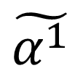
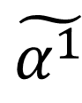
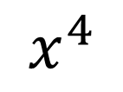
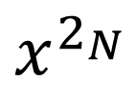
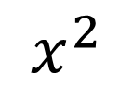
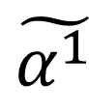
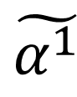
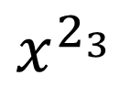
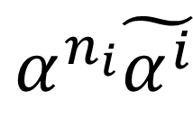
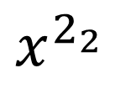
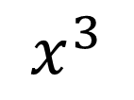
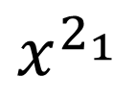
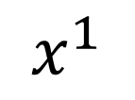
Data Structure
$$\tilde{α^{1}}$$
$$\tilde{α^{1}}$$
$$\tilde{α^{1}}$$
$$\tilde{α^{1}}$$
$$x^{1}$$
$$x^{2}$$
$$x^{3}$$
$$x^{4}$$
$$α^{n_{i}}\tilde{α^{i}}$$
x
Station
α
α
α
α
$$x^{2_{1}}$$
$$x^{2_{2}}$$
$$x^{2_{3}}$$
$$x^{2_{N}}$$
Bucketing
Embed
Attn α
xΠ
Concat
$${\tilde{x}}_{t}$$
z
Embed
Attn β
x(1-Π)
Externer
Factor

Slide 13
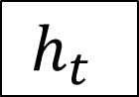
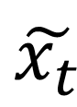
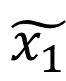

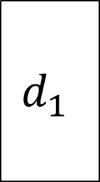
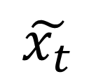
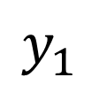

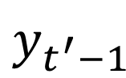

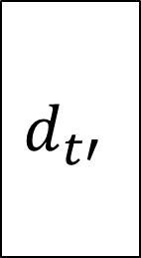
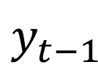
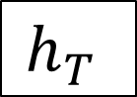
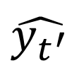

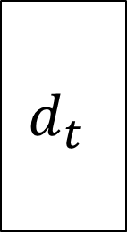
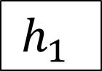
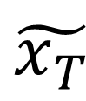
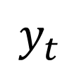
Data Structure
: Passenger flow forecasting
<Passenger Flow Forecasting>
$$y_{1}$$
$$y_{t}$$
$$\hat{y_{t^{′}}}$$
$$C$$
$${ θ}^{1}$$
$${ θ}^{t}$$
$${ θ}^{T}$$
$$h_{1}$$
$$h_{t}$$
$$d_{1}$$
$$d_{t}$$
$$d_{t′}$$
$$h_{T}$$
$$\tilde{x_{1}}$$
$$\tilde{x_{t}}$$
$$\tilde{x_{T}}$$
$$y_{t−1}$$
$$y_{t^{′}−1}$$
$$\tilde{x_{t}}$$

Slide 14
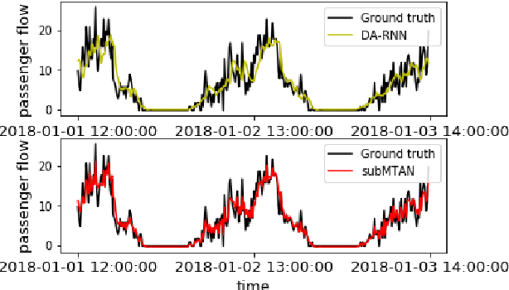
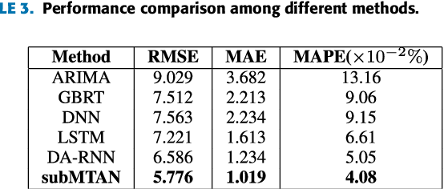
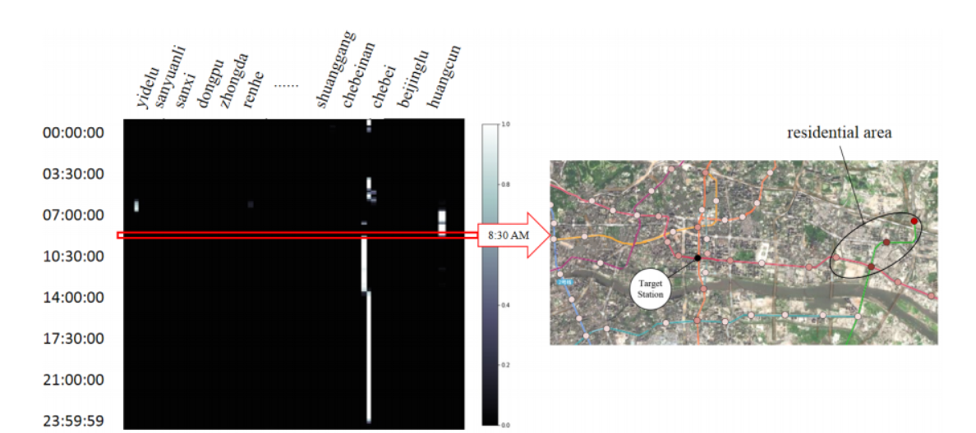
<Result>

Slide 15
Reference
YAN DANFENG AND WANG JING(2019), Subway Passenger Flow Forecasting With Multi-Station and External Factors

Slide 16
Thank You
Data Mining
Team

